Slide 1
Group 5 DAA
Presentation (HDB)
Members:
Hezhan
Tommy
Nancy
Ryan
Shafiq
Kristine

Slide 2






Flowchart
1
2
3
Problem Statement
Findings From EDA
Structural Factors
4
5
6
Location Factors
Machine Learning
Conclusion

Slide 3


Our Problem Statement
Context:
Data Analyst Team looking into HDB Resale Transactions
To advise HDB and the government (EXCO) on policies
How :
Analyse different factors and its effects
Then through development of ML model,
we give our insights

Slide 4
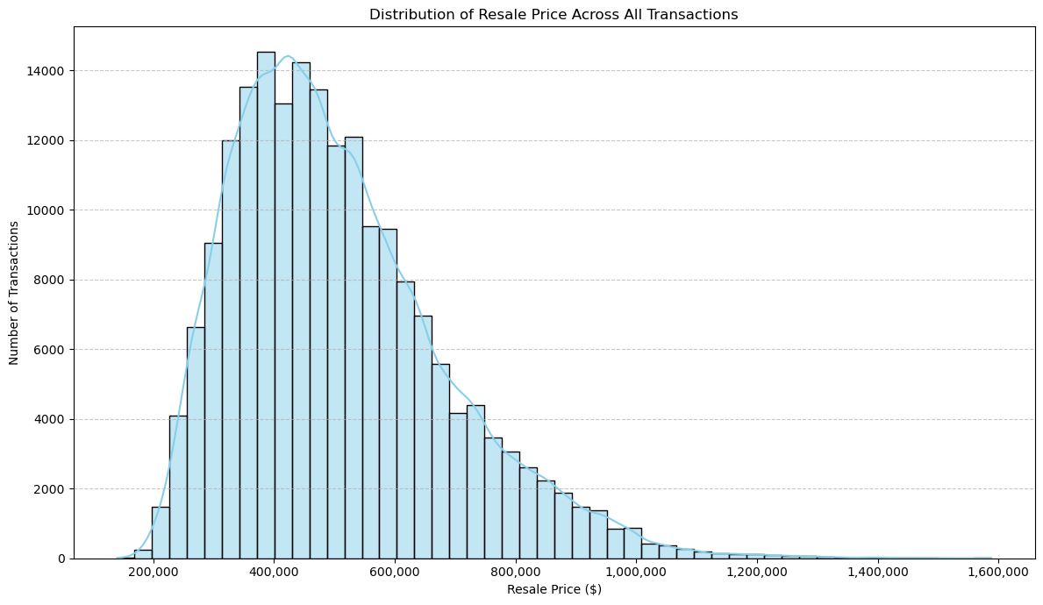
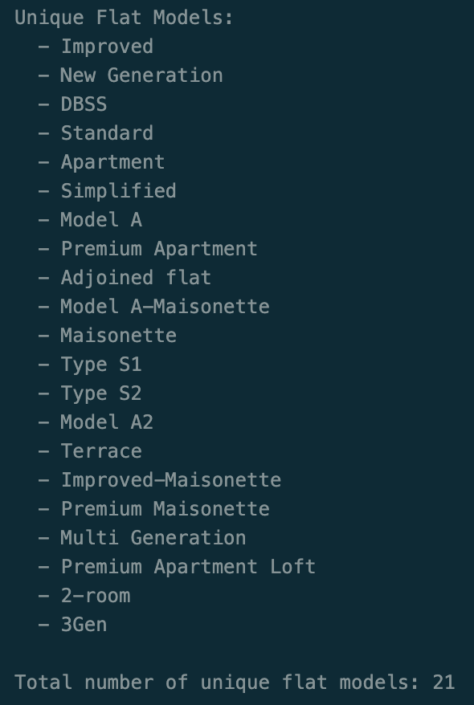
Exploratory Data Analysis Findings
Assumptions:
Disregarded Flat Model Analysis due to its growing irrelevance for future policy making and outdated nature.
Right skewed data distribution → from 800k and beyond are rare outliers, and could skew public perception of prices
400 - 600K range be the baseline for HDB should aim for to make housing affordable

Slide 5
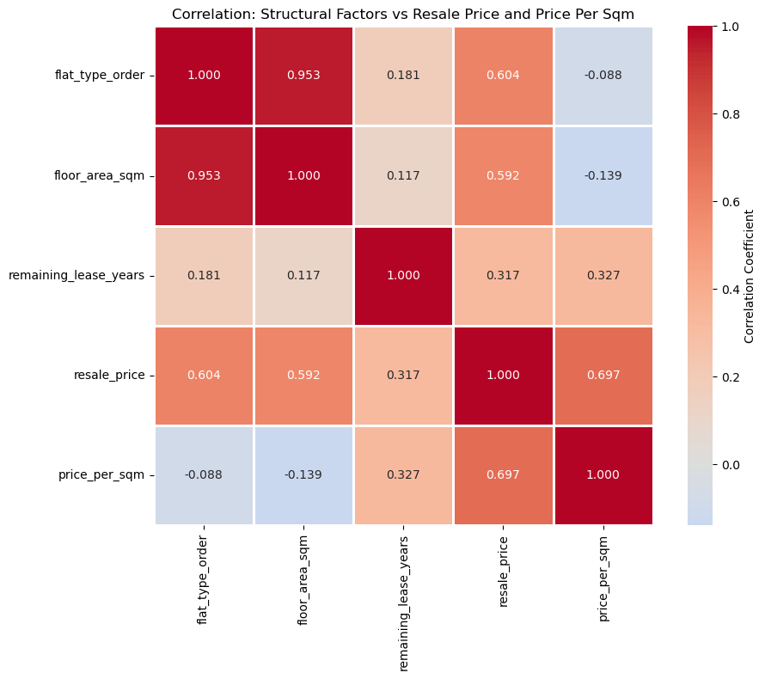
How Structural Factors Affect HDB Resale Prices
Correlation between Structural Factors and Price per SQM
Findings:
Per sqm chosen to remove size effect
Flat Types and Floor Area per sqm are negatively correlated to price per sqm
Remaining Lease (Years) are moderately positively correlated to price per sqm
Hence, aim to mitigate effects of lease decay

Slide 6
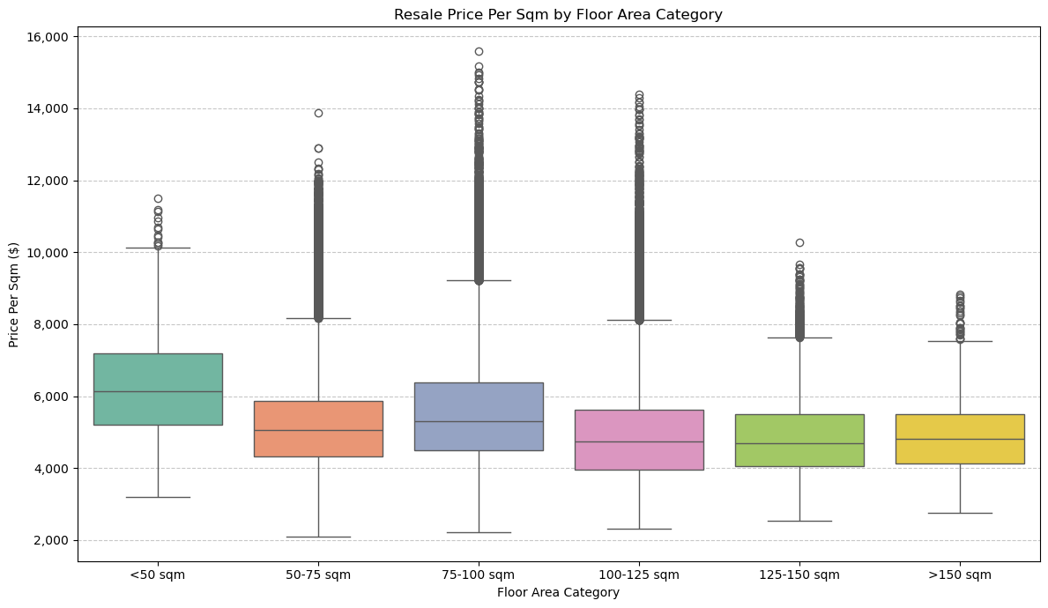
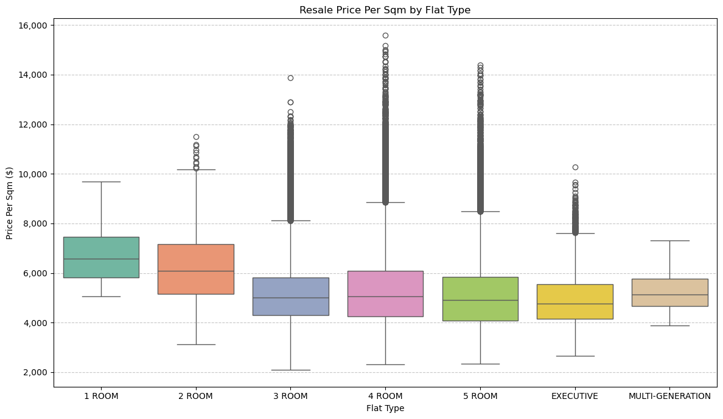
How Structural factors affect HDB Resale Prices
Analysis of Resale Price per SQM by Floor Area (SQM) and Flat Type
Data Context and Assumptions:
Using Resale Price per SQM as the Dependent Variable to remove Size Effect, as we already know that Bigger Houses and Houses w/ more Rooms tend to be more expensive (Higher Resale Price).
Findings:
Smaller Flat Sizes generally command Higher Price per SQM than Larger Flat Sizes
Flat Types follow the same trend → Lesser rooms = Higher Price per SQM
Inferences:
Affordability Premium → Sellers charge a greater price for Smaller Flats as Smaller flats tend to be more affordable → Lesser Floor Area = Lower Price Point = More affordable.
Greater Land Cost Proportion → Smaller flats have access to the same common amenities / areas such as Elevators, Fitness Corners, etc. → These Fixed Costs take up a greater proportion of total floor area resulting in a Higher Price per SQM.

Slide 7
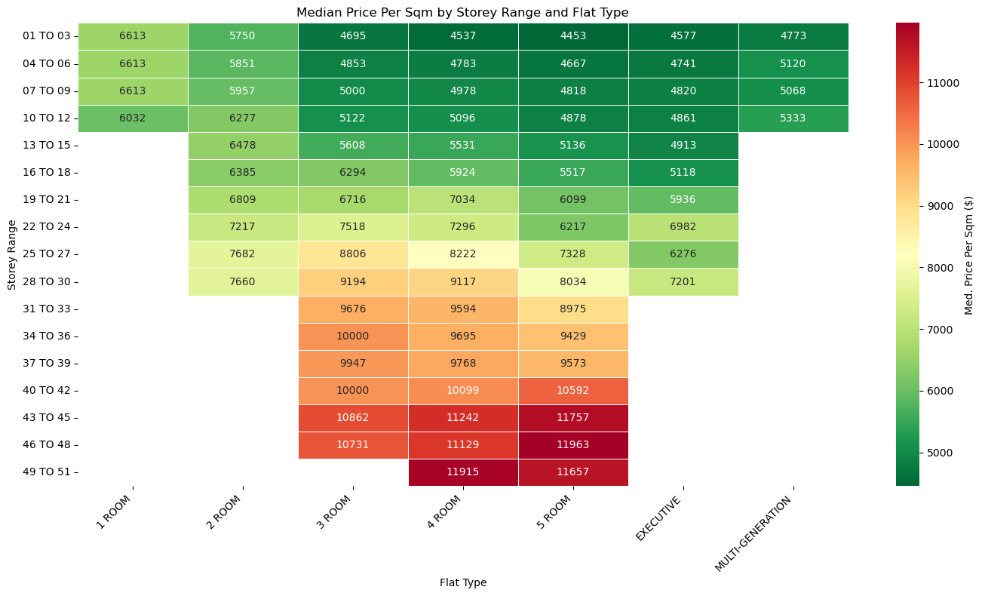
How structural factors affect HDB Resale Prices
Understanding how Flat Storey affects Resale Prices
Findings:
Height Premium on Flats → Across all flat types, the higher up the flat, the greater the median price per sqm

Slide 8
How structural factors affect HDB Resale Prices
Structural Factors and Resale Prices: Conclusion
3 Key Takeaways:
HDB Fixed Costs are spread out by unit not floor area → Larger Flats experience an Economies of Scale effect
Fixed Costs
Due to Singapore’s Land Scarcity + Constant Demand for Housing → Premium applied on Entry to buying a HDB
Land Scarcity
Height Premium is significant → Similar units can experience 150% premium applied
Height Premium

Slide 9
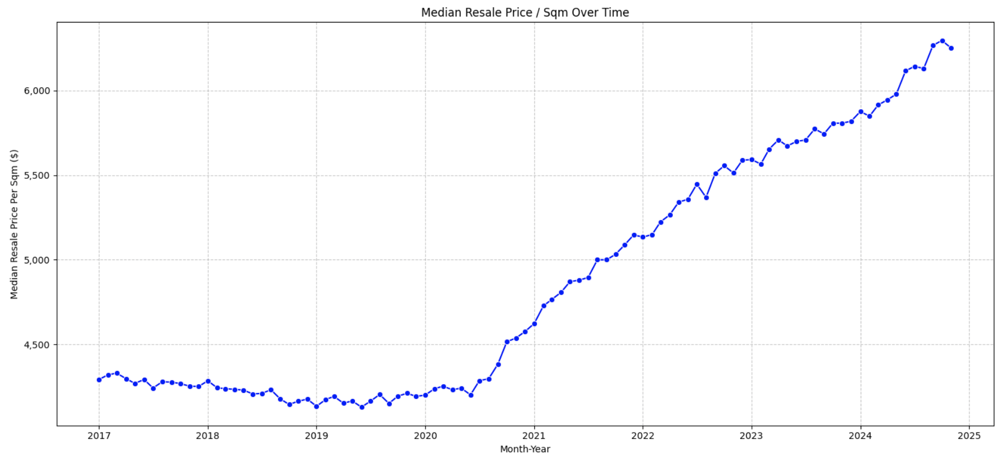
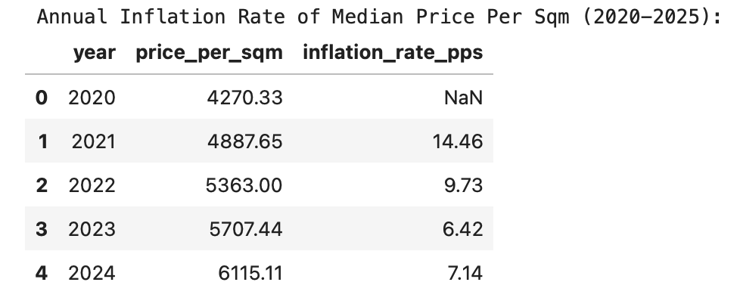
Affordability Crisis
How Locational Factors affect HDB Resale Prices
Findings:
Overall Median Prices over time show an upward trend from 2020 onwards
However, since 2020, Price Inflation has been showing decreasing trends
CAGR (Compound Annual Growth Rate) of Median Prices are around 5%, meaning as of the 2020, the Inflation Rate is still increasing at a greater rate than the CAGR --> Indicative of Housing becoming Less Affordable

Slide 10
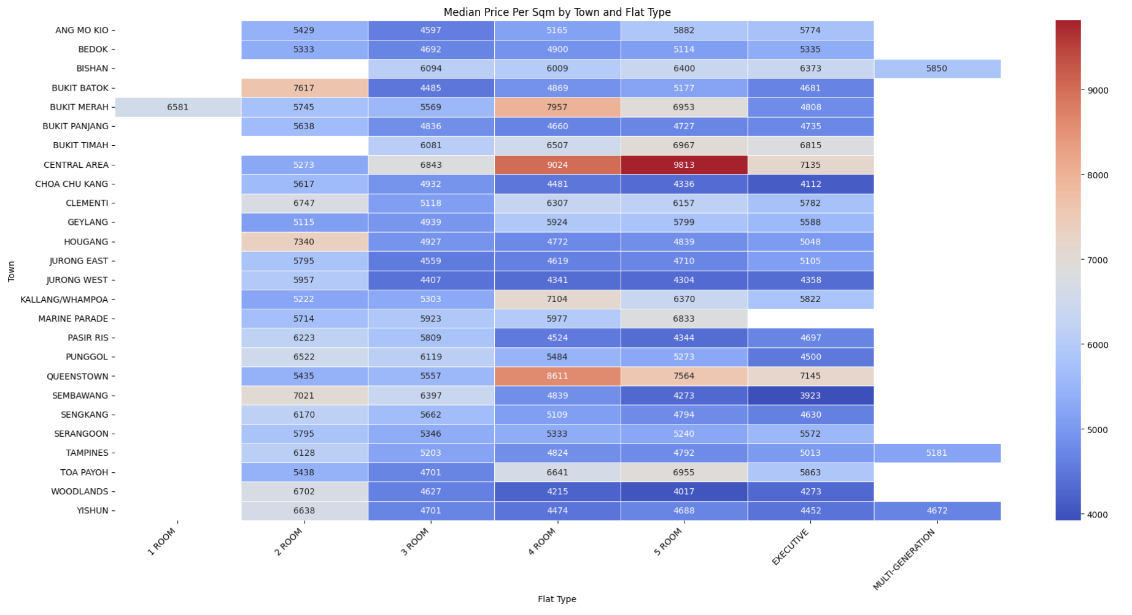
Geographic Inequality
How Locational Factors affect HDB Resale Prices
Key Locational Insights:
Central Area commands the highest $/sqm, reflecting strong demand and proximity to the CBD.
Mature estates (Bishan, Bukit Merah, Queenstown, Bukit Timah) show consistently high prices due to desirability and limited supply.
Non-mature estates (Sengkang, Punggol, Jurong West, Woodlands, Yishun) have lower $/sqm, making them more affordable for younger buyers.
Executive and multi-generation flats show large price gaps, with premiums in Central Area, Queenstown, Bishan, and Tampines.
A clear East–West price gradient emerges, with the East priced higher and the far West/North significantly lower.
Notable anomalies appear, such as Bukit Batok’s unusually high 1-room price and Queenstown’s strong prices outside the Central Area.

Slide 11
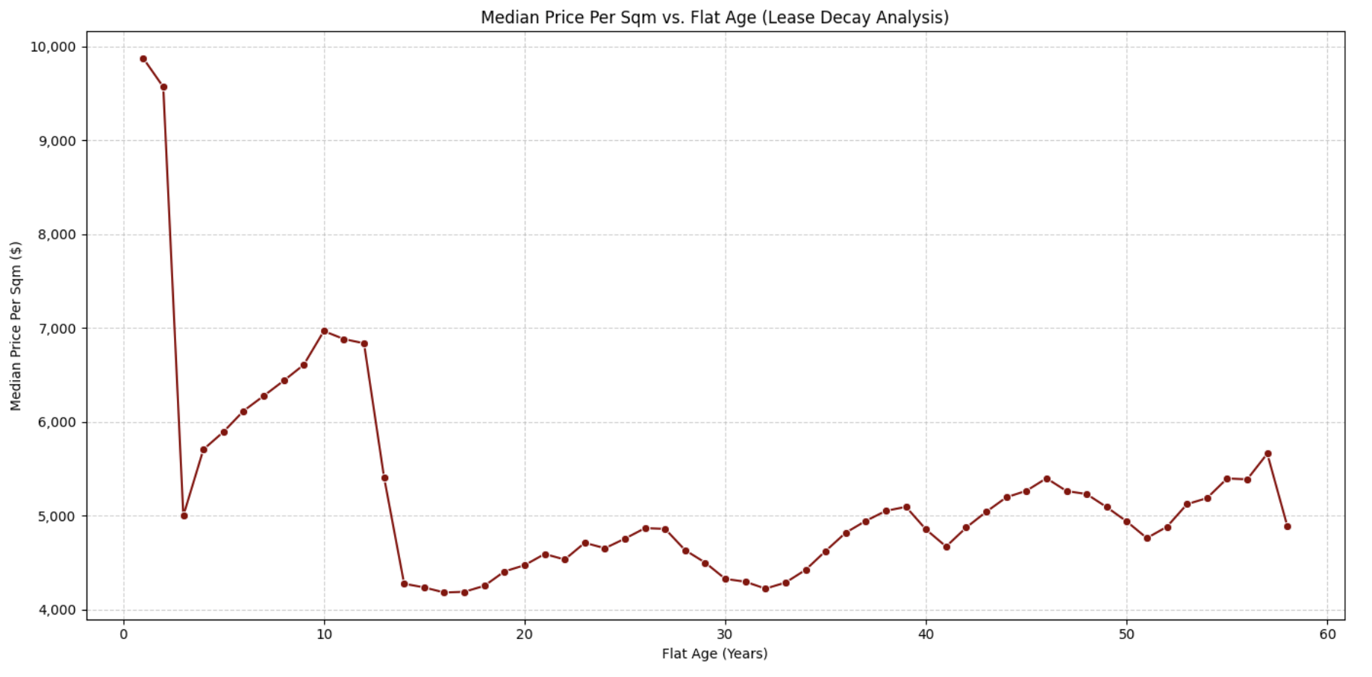
Lease Decay Impact
How Locational Factors affect HDB Resale Prices
Key findings:
New flats (<3 years) have the highest $/sqm due to full lease value and strong demand
Prices drop sharply after the first 5–10 years as lease decay begins
A small rebound around 8–12 years suggests location premiums in desirable estates
After 15 years, prices stabilise into a lower long-term band
Older flats (30–60 years) remain much cheaper due to significant lease depreciation

Slide 12




Locational Factors and Resale Prices: Conclusion
4 Key Takeaways
How Locational Factors affect HDB Resale Prices
1. Central & mature estates have the highest $/sqm due to CBD proximity and strong amenities
2. Peripheral and non-mature estates remain more affordable, attracting first-time buyers
3. Lease decay lowers prices over time, with the steepest drop after 5–10 years
4. Resale prices have risen rapidly since 2020, contributing to worsening housing affordability

Slide 13
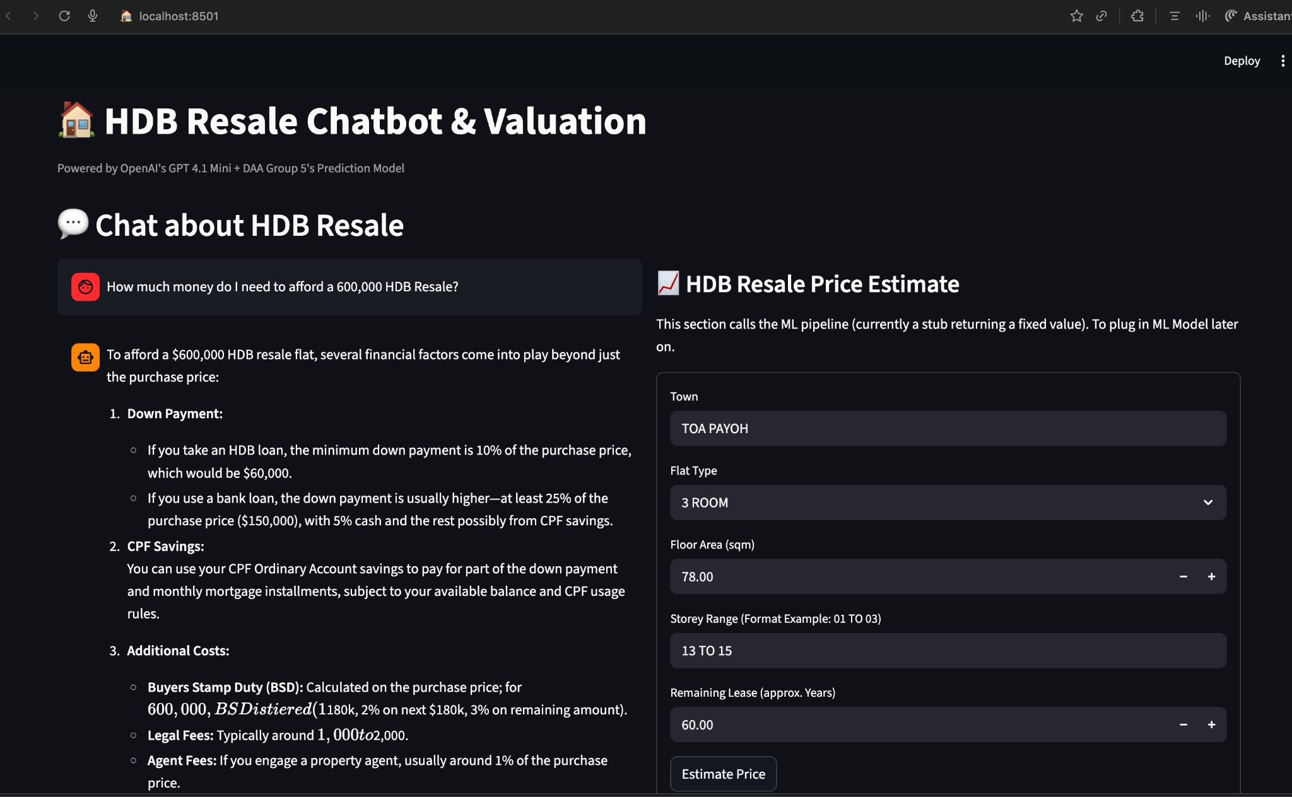
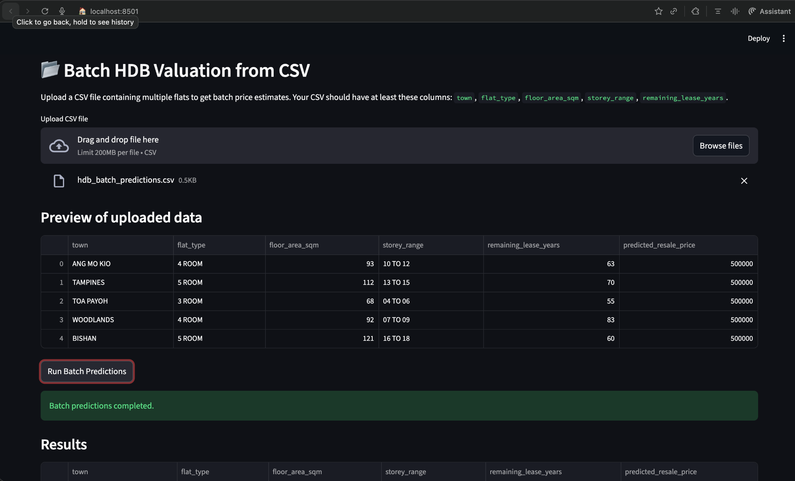
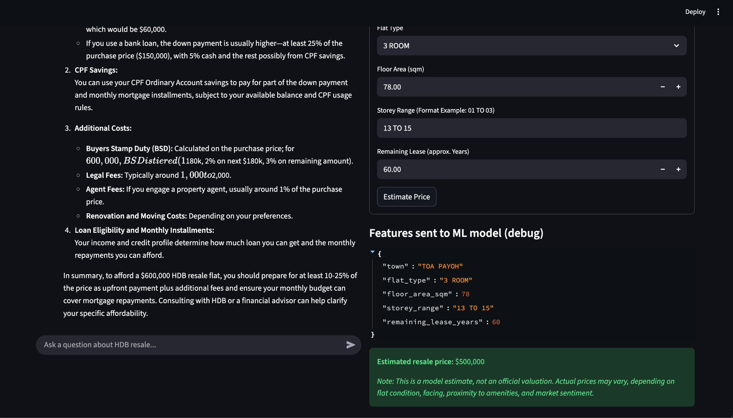
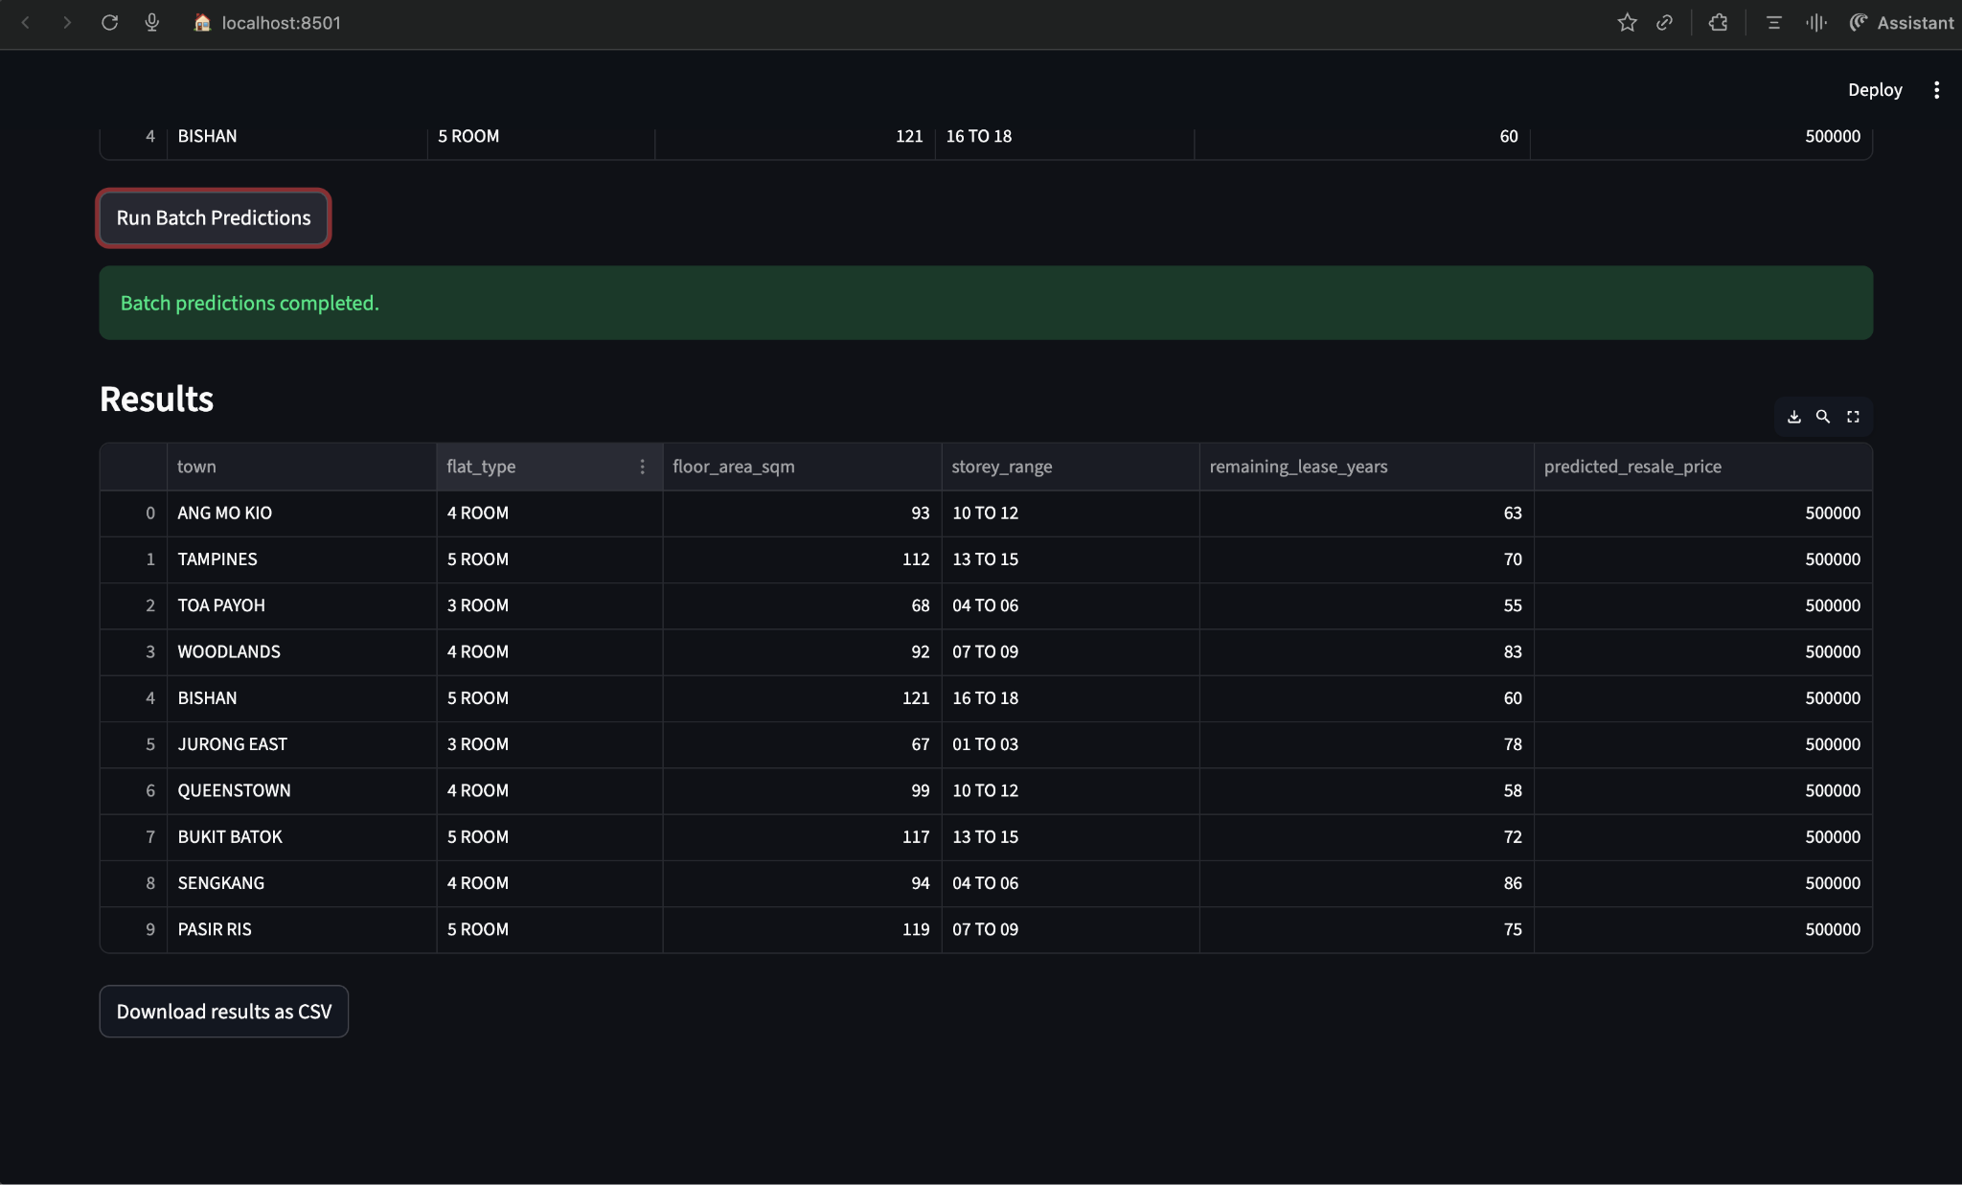
AI Powered Chatbot + Interactive Prediction Function
Snapshot of Chatbot + HDB Resale Price Estimate
Snapshot of Batch HDB Resale Price Prediction (via .CSV file upload)

Slide 14
Multiple Linear Regression: Output
Using predictive models to estimate resale prices
METRICS | Output | Explanation
MAE (Mean Average Error) | 50,786 | Average prediction error is 50,786 dollars
R² | 0.8604 | Model explains 86% of resale price variation
MAPE (Mean Absolute Percentage Error) | 16.34% | Average Percentage Error is 16.34%
MSE (Mean Square Error) | 4,355,580,859 | Mean Squared Error is 4.35 billion
RMSE (Root Mean Square Error) | 65,996 | Typical error magnitude is 65,996 dollars

Slide 15
Random Forest: Output
Using predictive models to estimate resale prices
METRICS | Output | Explanation
MAE (Mean Average Error) | 20,556 | Average prediction error is 20,556 dollars
R² | 0.9728 | Model explains 97% of resale price variation
MAPE (Mean Absolute Percentage Error) | 4.93% | Average Percentage Error is 4.93%
MSE (Mean Square Error) | 848,610,144 | Mean Squared Error is 848 million
RMSE (Root Mean Square Error) | 35,416 | Typical error magnitude is 35,416 dollars

Slide 16
XGBoost : Output
Using predictive models to estimate resale prices
METRICS | Output | Explanation
MAE (Mean Average Error) | 22,885 | Average prediction error is 22,885 dollars
R² | 0.9688 | Model explains 96% of resale price variation
MAPE (Mean Absolute Percentage Error) | 5.04% | Average Percentage Error is 5.04%
MSE (Mean Square Error) | 974,485,641.95 | Mean Squared Error is 974 million
RMSE (Root Mean Square Error) | 29,130 | Typical error magnitude is 29,130 dollars

Slide 17
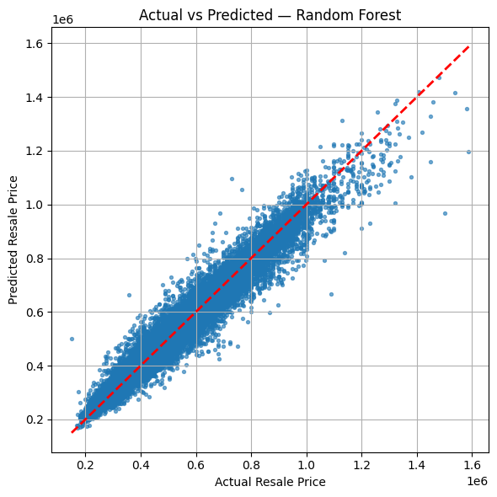
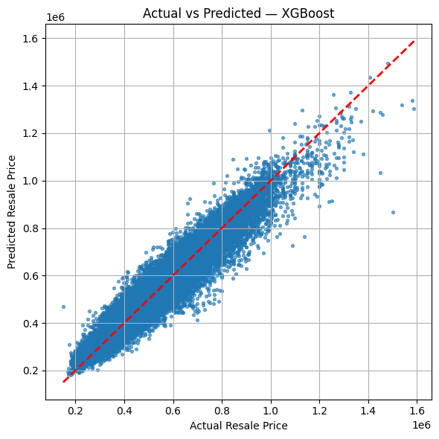
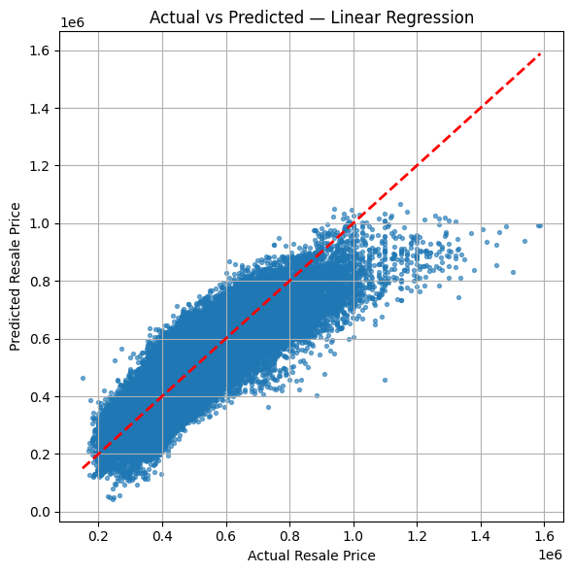
Actual vs Predicted Resale Prices
Using predictive models to estimate resale prices
X-axis: Actual Resale Price (in millions)
Y-axis: Predicted Resale Price (in millions)
Data Points: Blue dots representing individual resale transactions
Reference Line: A red dashed diagonal line (y = x), indicating perfect prediction alignment

Slide 18
Actual vs Predicted Graph Insights
Using predictive models to estimate resale prices
Models | Random Forest | Linear Regression | XGBoost
Scatter Plot Density | High density of points close to the red line | Wider scatter, especially at higher prices | High density of points close to the red line
Spread/Variance | Relatively low spread of points, indicating consistent predictions | Wider spread, suggesting higher variance and less reliable predictions | Relatively low spread of points, similar to XGBoost
Performance Indication | Strong Performance, as most predictions are close to actual values | Weaker performance; more predictions deviate from actual values | Strong performance, similar to Random Forest
Bias | Points are generally well-centered around the line | Wider scatter of points, and especially noticeable fanning at higher prices | Points are generally well-centered around the line
Overall Rank | Best | Weakest | Strong

Slide 19
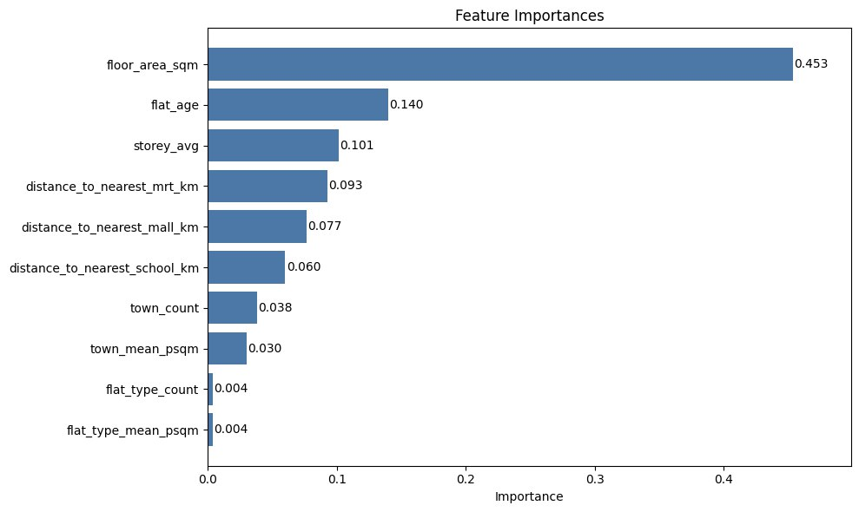
Random Forest: Features Importance
Using predictive models to estimate resale prices

Slide 20
Top Predictors of HDB Resale Prices
Using predictive models to estimate resale prices
Feature | Importance Score | Interpretation
floor_area_sqm | 0.453 | Most Important - Larger flats tend to cost more
flat_age | 0.140 | Older flats may be less valuable due to lease decay
storey _avg | 0.101 | Higher floors often fetch premium prices
distance_to_nearest_mrt_km | 0.093 | Proximity to MRT boosts value
distance_to_nearest_mall_km | 0.077 | Convenience matters
Floor area, flat age and storey level are the strongest drivers of resale price predictions
Accessibility factors (MRT, malls, schools) play a moderate role in affecting resale prices
Overall, model highlights that size and age dominate resale value.

Slide 21
Machine Learning Models: Findings
Using predictive models to estimate resale prices
Performance Aspect | Supporting Evidence
Superior Accuracy | Random Forest exhibits a high density of points close to the red line, confirming its superior accuracy in predicting resale price.
High Reliability | Random Forest has a relatively low spread of points (variance), indicating that is predictions are highly consistent and reliable.
Non- Linear | Random Forest strong performance shows the resale price relationship is complex and non-linear—something Random Forest handles well.
Minimal Bias | The predictions are generally well-centered around the ideal line suggesting that the model is not consistently over or underestimating the price.
Conclusion:
The Random Forest model delivers highly accurate and reliable predictions, effectively capturing the complex non-linear relationships while being unbiased in predicting complex resale price patterns

Slide 22
1st Determinant: HDB Supply
Key determinants that policymakers can target to maintain housing affordability
Data Insights:
Flat size is the most significant factor for buyers
Specifically the 4-room and 5-room are the most popular, driving up the resale prices
Recommendation:
Increase the supply of 4-room and 5-room units
Result:
This aligns supply with demand, reduces price pressure, and supports long-term affordability

Slide 23
2nd Determinant: HDB Demand
Key determinants that policymakers can target to maintain housing affordability
Data Insights:
Distance to MRT is the 4th most important factor for buyers
Price pressures especially concentrated in the central MRT-accessible areas of Singapore
Recommendation:
Align future BTO launches with upcoming MRT lines
Result:
This spreads demand and reduces price pressure in already MRT-rich areas

Slide 24
3rd Determinant: Construction & Development Costs
Key determinants that policymakers can target to maintain housing affordability
Data Insights:
Larger and higher-storey flats are the top factors for buyers
Recommendation:
Standardise HDB design components (e.g., modular layouts, pre-approved designs)
Result:
This reduces construction complexity, speeds up design and lowers building costs

Slide 25
References
Housing and Development Board. (2025, October 15). | HDB launches 9,144 flats across 10 projects in October 2025 BTO sales exercise.
https://www.hdb.gov.sg/about-us/news-and-publications/press-releases/october-2025-bto-sales-exercise
Reporter, S. (2025, November 3). Singapore HDB resale prices to rise by up to 4% in 2025. Real Estate Asia. https://realestateasia.com/residential/news/singapore-hdb-resale-prices-rise-4-in-2025
Today, N. H. M. A. (2022, December 7). HDB reveals for the first time breakdown of development costs of BTO flats, reiterates it “doesn’t apply profit margin on costs.” TODAY. https://www.todayonline.com/singapore/hdb-bto-development-cost-breakdown-2065221
Housing and Development Board. (n.d.). HDB | Standardisation. https://www.hdb.gov.sg/about-us/research-and-innovation/construction-productivity/standardisation-
(IPS Working Papers No.53, C. Gee and G. Lim, 2024)
https://lkyspp.nus.edu.sg/docs/default-source/ips/ips-working-paper-no-53_public-housing-in-singapore_four-principles-for-public-deliberation.pdf

Slide 26
Thank You!

